Slide 1
Introduction to Compiling

Slide 2
Compilers and Interpreters
“Compilation”
  Translation of a program written in a source language into a semantically equivalent program written in a target language
  Oversimplified view:
Input
Source
Program
Compiler
Target
Program
Error messages
Output

Slide 3
Requirement of Compilation
In order to translate statements in a language, one needs to understand both
  Structure of the language: the way “sentences" are constructed in the language
  Meaning of the language: what each “sentence" stands for.
Terminology:
    Structure ≡ Syntax
    Meaning ≡ Semantics

Slide 4
Analysis-Synthesis Model of Compilation
Two parts to compilation:
  Analysis
    Breaks up the source program into pieces and imposes a hierarchical structure
    Creates intermediate representation of the source program
    Determines the operations and records them in a tree structure, syntax tree
    Known as front end of compiler

Slide 5
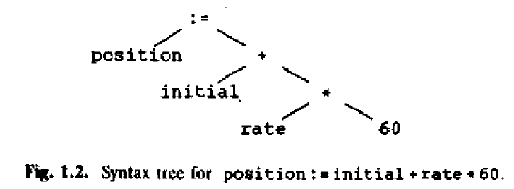
Analysis-Synthesis Model of Compilation(cont..)
  Synthesis
    Constructs the target program from intermediate representation
    Takes the tree structure and translates the operations into the target program
    Known as back end of compiler

Slide 6
Phases of Compilation
Source Program
1
Lexical Analyzer
2
Syntax Analyzer
3
Semantic Analyzer
Symbol-table Manager
Error Handler
4
Intermediate Code Generator
5
Code Optimizer
6
Code Generator
Target Program

Slide 7
Phases of Compilation(cont..)
Lexical Analysis: Generates the “tokens” in the source program
Syntax Analysis : Recognizes “sentences" in the program using the syntax of the language
Semantic Analysis: Infers information about the program using the semantics of the language
Intermediate Code Generation: Generates “abstract” code based on the syntactic structure of the program and the semantic information
Optimization: Refines the generated code using a series of optimizing transformations
Final Code Generation: Translates the abstract intermediate code into specific machine instructions

Slide 8
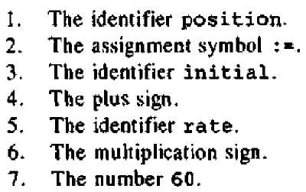
Lexical analysis (Scanning)
Characters are grouped into tokens.

Slide 9
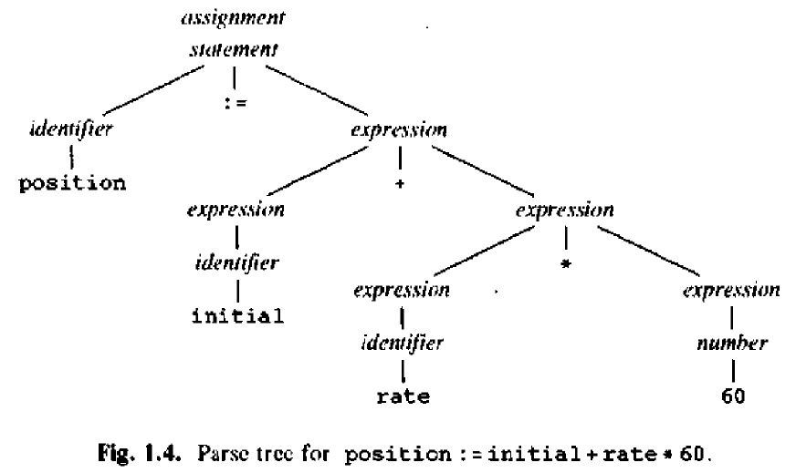
Syntax analysis (Parsing)
Grouping tokens into grammatical phrases
Character groups recorded in symbol table
Represented by a parse tree:

Slide 10
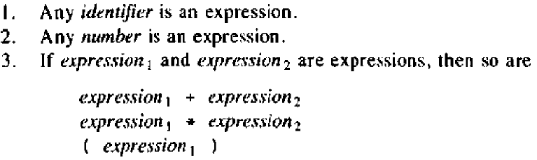
Syntax analysis (Parsing)
Hierarchical structure usually expressed by recursive rules
Rules for definition of expression:

Slide 11
Syntax analysis (Parsing)
Expression grammar
  Exp Exp ‘+’ Exp
  | Exp ‘*’ Exp
  | Id
  | Number
Syntax Tree
- compressed representation of parse tree
- internal nodes represents operators
- operands of an operator are the children of the node for
that operator

Slide 12
Syntax analysis (cont..)
Syntax Tree
:=
position +
initial *
rate 60

Slide 13
Semantic analysis
Checks the source program for semantic errors
Gathers type information for subsequent code generation
Performs type checking
  Operator operand compatibility
Identifies the operators and the operands of expressions and statements

Slide 14
Symbol-Table Management
Symbol table – data structure with a record for each identifier and its attributes
Attributes include storage allocation, type, etc
All the compiler phases insert and modify the symbol table

Slide 15
Error Detection, Recovery and Reporting
Each phase can encounter error
Specific types of error can be detected in specific phases
  Lexical Error: int abc, 1num;
  Syntax Error: total = capital + rate year;
  Semantic Error: value = myarray [realIndex];
Able to proceed and process further the rest of the program after an error detected

Slide 16
Intermediate code generation
Program representation for an abstract machine
Have two properties
  Easy to produce
  Easy to translate into target program
Three-address code is a commonly used form – similar to assembly language
Example:
temp1 := 60
temp2 := rate * temp1
temp3 := initial + temp2
position := temp3

Slide 17
Code optimization and generation
Code Optimization
  Improve intermediate code by producing code that runs faster
Code Generation
  Generate target code, which is machine code or assembly code

Slide 18
Reviewing the Entire Process
position := initial + rate *10
lexical analyzer
id1 := id2 + id3 * 10
syntax analyzer
:=
id1
+
id2
*
id3
10
semantic analyzer
:=
Symbol Table
id1
+
Errors
id2l
*
position ....
initial ….
rate….
id3
inttoreal
10
intermediate code generator

Slide 19
Reviewing the Entire Process
Symbol Table
Errors
position ....
initial ….
rate….
intermediate code generator
temp1 := inttoreal(10)
temp2 := id3 * temp1
temp3 := id2 + temp2
id1 := temp3
3 address code
code optimizer
temp1 := id3 * 10.0
id1 := id2 + temp1
final code generator
MOVF id3, R2
MULF #10.0, R2
MOVF id2, R1
ADDF R2, R1
MOVF R1, id1

Slide 20
The Grouping of Phases
Compiler front and back ends:
  Front end:
    Analysis steps + Intermediate code generation
    Depends primarily on the source language
    Machine independent
  Back end:
    Code optimization and generation
    Independent of source language
    Machine dependent

